Slide 1
Microcontrollers vs. microprocessors
Microcontroller units (MCUs) and microprocessor units (MPUs) are two kinds of integrated circuits that, while similar in certain ways, are very different in many others. Replacing antiquated multi-component central processing units (CPUs) with separate logic units, these single-chip processors are both extremely valuable in the continued development of computing technology.
However, microcontrollers and microprocessors differ significantly in component structure, chip architecture, performance capabilities and application.
Microcontrollers do not require additional peripherals or complex operating systems to function, while microprocessors do. Both circuits contain CPUs, however, microcontrollers also integrate memory, input/output (I/O) components and other varied peripherals.

Slide 2
Understanding microcontrollers
Essentially, a microcontroller is a small computer on a single chip, containing a processor core (or cores), operational memory (RAM) and electrically erasable programmable read-only memory (EEPROM) for program memory. Optimized to function as standalone units, microcontroller integrations improve real-time signal processing and make these compact units ideal for controlling specific tasks or duties within embedded systems.
Key components of a microcontroller:
Central processing unit (CPU): Colloquially referred to as the computer’s “brain,” the CPU is responsible for executing instructions and controlling operations.
Memory: Microcontrollers contain both volatile memory (RAM), which stores temporary data that may be lost if the system loses power, and non-volatile flash memory (ROM) for storing the microcontroller’s programming code.
Peripherals: Depending on the intended application, a microcontroller may contain various peripheral components, such as I/O interfaces, timers, counters, analog-to-digital converters (ADCs) and communication protocols (UART, SPI, I2C).
Lightweight, small and requiring comparatively low power, microcontrollers are ideal for battery-operated electronic devices like smartphones, smartwatches and other wearables.

Slide 3
Understanding microprocessors
Microprocessors are the predominant type of computer processor, integrating all the required components of a CPU into a single circuit. MPUs combine the arithmetic, logic and control units of antiquated CPU computer systems into a single multipurpose, clock-driven and register-based piece of hardware. While microprocessors do not contain on-chip program memory, they are optimized for demanding general-purpose use and designed to support and be supported by specialized computer peripherals.
Key components of a microprocessor:
Modern microprocessors combine millions of small transistors, resistors and diodes assembled on a semiconductor material to create the key components of a CPU.
Arithmetic logic unit (ALU): The main logic unit of the CPU, this component executes logical operations including mathematical calculations and data comparisons.
Control unit (CU): The CU circuit interprets instructions and initiates their execution, directing the basic operations of the processor.
Registers: Small, fast memory storage used by a CPU to temporarily hold data and instructions during computational processes.
Cache memory: Microprocessors and CPUs use cache memory, a high-speed form of memory located close to the CPU, to store frequently accessed data to accelerate performance.
Processor cores: Individual processing units within microprocessors are known as cores. Modern processors frequently incorporate multiple cores (dual-core, quad-core) allowing for parallel processing by enabling the performance of multiple tasks simultaneously.
I/O modules: A microprocessor’s I/O components are critical for managing the flow of data to and from the CPU, including any additional computer peripherals including networking peripherals such as Ethernet ports or Wi-Fi units.

Slide 4
Microprocessor vs. microcontroller
Parameter | Microprocessor | Microcontroller
Definition | Microprocessors can be understood as the heart of a computer system. | Microcontrollers can be understood as the heart of an embedded system.
What is it? | A microprocessor is a processor where the memory and I/O component are connected externally. | A microcontroller is a controlling device wherein the memory and I/O output component are present internally.
Circuit complexity | The circuit is complex due to external connection. | Microcontrollers are present on chip memory. The circuit is less complex.
Memory and I/O components | The memory and I/O components are to be connected externally. | The memory and I/O components are available.
Compact system compatibility | Microprocessors can't be used in compact system. | Microcontrollers can be used with a compact system.
Efficiency | Microprocessors are not efficient. | Microcontrollers are efficient.
Zero status flag | Microprocessors have a zero status flag. | Microcontroller doesn't have a zero status flag.
Number of registers | Microprocessors have less number of registers. | Microcontrollers have more number of registers.
Applications | Microprocessors are generally used in personal computers. | Microcontrollers are generally used in washing machines, and air conditioners.

Slide 5
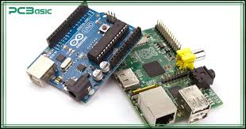
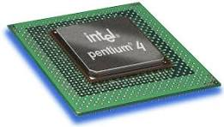
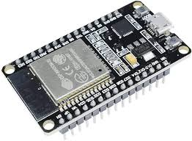
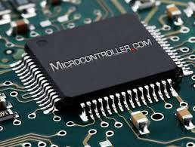
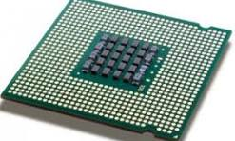
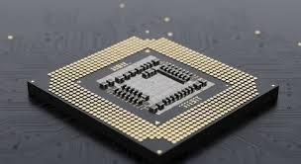
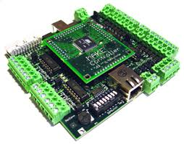
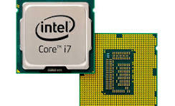
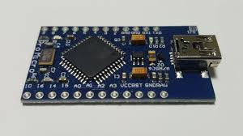
Microprocessor vs. microcontroller

